Slide 1
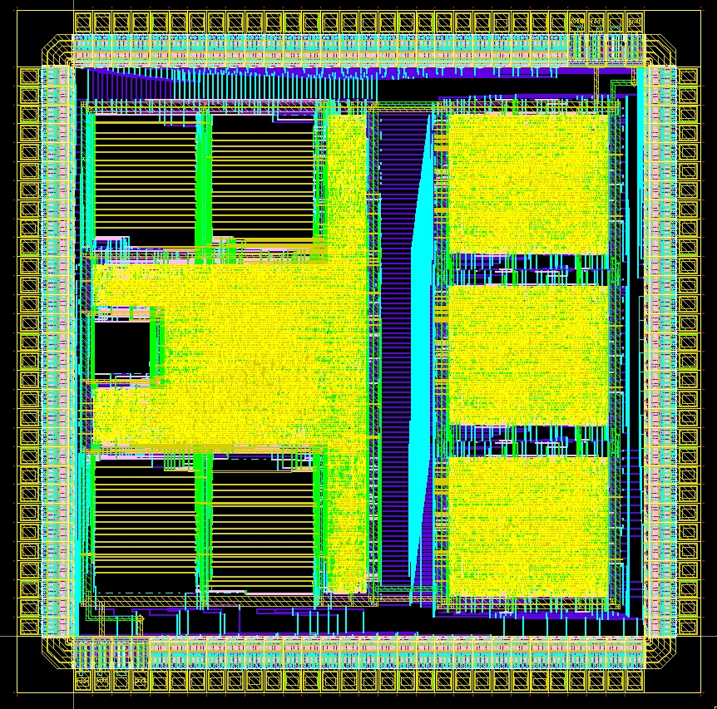
Digital Systems and Microprocessor Design (H7068)
9.2. Jumps and loops
Daniel Roggen
d.roggen@sussex.ac.uk

Slide 2
Content
Loops with unconditional jumps
Conditional jumps
Conditional loops
C-style loops to assembler

Slide 3
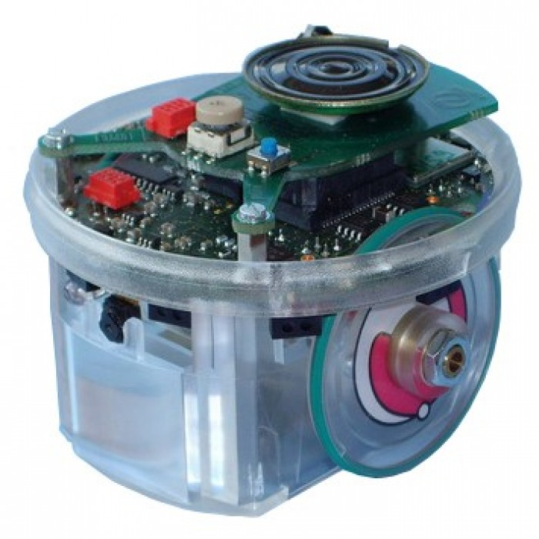
Loop with unconditional jump
Unconditional jumps: changes the value of PC to destination
  jmp dst
To do forever a task
  Polling-based event loop
  sensing-actuation loop
Example:
  Read sensors
  Compute motor speed
  Set motor speed

Slide 4
Loop with unconditional jump
PC Adr Instr RA RB RC RD
-> 00 mov ra,3h 0 0 0 0
02 sub ra,1h
04 jmp 2h
06 ???

Slide 5
Loop with unconditional jump
PC Adr Instr RA RB RC RD
00 mov ra,3h 3 0 0 0
-> 02 sub ra,1h
04 jmp 2h
06 ???

Slide 6
Loop with unconditional jump
PC Adr Instr RA RB RC RD
00 mov ra,3h 2 0 0 0
02 sub ra,1h
-> 04 jmp 2h
06 ???

Slide 7
Loop with unconditional jump
PC Adr Instr RA RB RC RD
00 mov ra,3h 2 0 0 0
-> 02 sub ra,1h
04 jmp 2h
06 ???

Slide 8
Loop with unconditional jump
PC Adr Instr RA RB RC RD
00 mov ra,3h 1 0 0 0
02 sub ra,1h
-> 04 jmp 2h
06 ???

Slide 9
Loop with unconditional jump
PC Adr Instr RA RB RC RD
00 mov ra,3h 1 0 0 0
-> 02 sub ra,1h
04 jmp 2h
06 ???

Slide 10
Loop with unconditional jump
PC Adr Instr RA RB RC RD
00 mov ra,3h 0 0 0 0
02 sub ra,1h
-> 04 jmp 2h
06 ???

Slide 11
Loop with unconditional jump
PC Adr Instr RA RB RC RD
00 mov ra,3h 0 0 0 0
-> 02 sub ra,1h
04 jmp 2h
06 ???

Slide 12
Loop with unconditional jump
PC Adr Instr RA RB RC RD
00 mov ra,3h FF 0 0 0
02 sub ra,1h
-> 04 jmp 2h
06 ???

Slide 13
Loop with unconditional jump
PC Adr Instr RA RB RC RD
00 mov ra,3h FF 0 0 0
-> 02 sub ra,1h
04 jmp 2h
06 ???

Slide 14
Loop with unconditional jump
PC Adr Instr RA RB RC RD
00 mov ra,3h FE 0 0 0
02 sub ra,1h
-> 04 jmp 2h
06 ???

Slide 15
Loop with unconditional jump
PC Adr Instr RA RB RC RD
00 mov ra,3h FE 0 0 0
-> 02 sub ra,1h
04 jmp 2h
06 ???

Slide 16
Loop with unconditional jump
PC Adr Instr RA RB RC RD
00 mov ra,3h FE 0 0 0
-> 02 sub ra,1h
04 jmp 2h
06 ???
This line is never executed!

Slide 17
Conditional jumps
Conditional jumps: changes the value of PC if a condition is met.
Condition is tested by checking the flags (carry, zero).
Flags are set by a prior comparison
JA: jump if above
  Jumps if Zero=0 and Carry=0
JB: jump if below
  Jumps if Zero=0 and Carry=1
JE: jump if equal
  Jumps if Zero=1
And the opposite: JNA, JNB, JNE (not above, not below, not equal)

Slide 18
Loop with conditional jump (jne)
Loop with variable from startvalue to 0 (inclusive)

Slide 19
Loop with conditional jump (jne)
PC Adr Instr RA RB RC RD FLAGS
0 0 0 0
-> 00 mov ra,3h
02 sub ra,1h
04 cmp ra,0h
06 jne 02
08 ???

Slide 20
Loop with conditional jump (jne)
PC Adr Instr RA RB RC RD FLAGS
3 0 0 0
00 mov ra,3h
-> 02 sub ra,1h
04 cmp ra,0h
06 jne 02
08 ???

Slide 21
Loop with conditional jump (jne)
PC Adr Instr RA RB RC RD FLAGS
2 0 0 0
00 mov ra,3h
02 sub ra,1h
-> 04 cmp ra,0h
06 jne 02
08 ???

Slide 22
Loop with conditional jump (jne)
PC Adr Instr RA RB RC RD FLAGS
2 0 0 0
00 mov ra,3h
02 sub ra,1h
04 cmp ra,0h
-> 06 jne 02
08 ???

Slide 23
Loop with conditional jump (jne)
PC Adr Instr RA RB RC RD FLAGS
2 0 0 0
00 mov ra,3h
-> 02 sub ra,1h
04 cmp ra,0h
06 jne 02
08 ???

Slide 24
Loop with conditional jump (jne)
PC Adr Instr RA RB RC RD FLAGS
1 0 0 0
00 mov ra,3h
02 sub ra,1h
-> 04 cmp ra,0h
06 jne 02
08 ???

Slide 25
Loop with conditional jump (jne)
PC Adr Instr RA RB RC RD FLAGS
1 0 0 0
00 mov ra,3h
02 sub ra,1h
04 cmp ra,0h
-> 06 jne 02
08 ???

Slide 26
Loop with conditional jump (jne)
PC Adr Instr RA RB RC RD FLAGS
1 0 0 0
00 mov ra,3h
-> 02 sub ra,1h
04 cmp ra,0h
06 jne 02
08 ???

Slide 27
Loop with conditional jump (jne)
PC Adr Instr RA RB RC RD FLAGS
0 0 0 0
00 mov ra,3h
02 sub ra,1h
-> 04 cmp ra,0h
06 jne 02
08 ???

Slide 28
Loop with conditional jump (jne)
PC Adr Instr RA RB RC RD FLAGS
0 0 0 0 Z
00 mov ra,3h
02 sub ra,1h
04 cmp ra,0h
-> 06 jne 02
08 ???

Slide 29
Loop with conditional jump (jne)
PC Adr Instr RA RB RC RD FLAGS
0 0 0 0 Z
00 mov ra,3h
02 sub ra,1h
04 cmp ra,0h
06 jne 02
-> 08 ???

Slide 30
Loop with conditional jump (jne)
PC Adr Instr RA RB RC RD FLAGS
2 0 0 0 Z
00 mov ra,3h
02 sub ra,1h
04 cmp ra,0h
06 jne 02
-> 08 ???
Program continues execution

Slide 31
C to assembler loops
In C the syntax for a for loop is:
for(<initialization>;<condition>; <update>) {code}
Example: for(i=3; i != 0; i--) {....}
  i will take the value: 3, 2, 1.
Can be easily translated to assembler

Slide 32
C to assembler loops: alternative 1
for(<initialization>;<condition>; <update>) {code}
  initialization
  test:
  test condition
  if condition then jump to loopcode
  jump to endofloop
  loopcode:
  code
  update
  jump to test
  endofloop:
  rest of program
unconditional
conditional

Slide 33
C to assembler loops: alternative 2
for(<initialization>;<condition>; <update>) {code}
  initialization
  test:
  test condition
  if not condition then jump to endofloop
  code
  update
  jump to test
  endofloop:
  rest of program
unconditional
conditional
This requires to negate the condition!
Processors usually provide conditional jumps if condition (je,ja,jb) and conditional jumps if not condition (jne,jna,jnb)

Slide 34
C to assembler loops
With alternative 1 the conditional jump is to a nearby address (instruction skip)
Alternative 2 leads to more compact code
Some processors have "relative jumps" that allow to change PC by an offset
  On Intel/AMD x86 the "short relative jump" allows to offset PC by up to -128 to +127 bytes
What happens on x86 if the loop code is longer than 127 bytes?
  Alternative 2 cannot be used with short relative jump!
  Alternative 1 must be used
Programming influenced by processor architecture!
That is why higher level languages (e.g. C) and compilers are used: they can optimize the code
Programming influenced by processor architecture!
Higher level languages (e.g. C) and compilers allow to select the right assembler construct to optimize the code

Slide 35
C to assembler loops
for(i=3; i != 0; i--) {....}
Alternative 2

Slide 36
for(i=3; i != 0; i--) {....}
PC Adr Instr RA RB RC RD FLAGS
0 0 0 0
-> 00 mov ra,3h
02 cmp ra,0h
04 je 0eh
06 ...
08 ...
0A sub ra,1h
0C jmp 02
0E ???

Slide 37
for(i=3; i != 0; i--) {....}
PC Adr Instr RA RB RC RD FLAGS
3 0 0 0
00 mov ra,3h
-> 02 cmp ra,0h
04 je 0eh
06 ...
08 ...
0A sub ra,1h
0C jmp 02
0E ???

Slide 38
for(i=3; i != 0; i--) {....}
PC Adr Instr RA RB RC RD FLAGS
3 0 0 0
00 mov ra,3h
02 cmp ra,0h
-> 04 je 0eh
06 ...
08 ...
0A sub ra,1h
0C jmp 02
0E ???

Slide 39
for(i=3; i != 0; i--) {....}
PC Adr Instr RA RB RC RD FLAGS
3 0 0 0
00 mov ra,3h
02 cmp ra,0h
04 je 0eh
-> 06 ...
08 ...
0A sub ra,1h
0C jmp 02
0E ???

Slide 40
for(i=3; i != 0; i--) {....}
PC Adr Instr RA RB RC RD FLAGS
3 0 0 0
00 mov ra,3h
02 cmp ra,0h
04 je 0eh
06 ...
08 ...
-> 0A sub ra,1h
0C jmp 02
0E ???

Slide 41
for(i=3; i != 0; i--) {....}
PC Adr Instr RA RB RC RD FLAGS
2 0 0 0
00 mov ra,3h
02 cmp ra,0h
04 je 0eh
06 ...
08 ...
0A sub ra,1h
-> 0C jmp 02
0E ???

Slide 42
for(i=3; i != 0; i--) {....}
PC Adr Instr RA RB RC RD FLAGS
2 0 0 0
00 mov ra,3h
-> 02 cmp ra,0h
04 je 0eh
06 ...
08 ...
0A sub ra,1h
0C jmp 02
0E ???

Slide 43
for(i=3; i != 0; i--) {....}
PC Adr Instr RA RB RC RD FLAGS
2 0 0 0
00 mov ra,3h
02 cmp ra,0h
-> 04 je 0eh
06 ...
08 ...
0A sub ra,1h
0C jmp 02
0E ???

Slide 44
for(i=3; i != 0; i--) {....}
PC Adr Instr RA RB RC RD FLAGS
2 0 0 0
00 mov ra,3h
02 cmp ra,0h
04 je 0eh
-> 06 ...
08 ...
0A sub ra,1h
0C jmp 02
0E ???

Slide 45
for(i=3; i != 0; i--) {....}
PC Adr Instr RA RB RC RD FLAGS
2 0 0 0
00 mov ra,3h
02 cmp ra,0h
04 je 0eh
06 ...
08 ...
-> 0A sub ra,1h
0C jmp 02
0E ???

Slide 46
for(i=3; i != 0; i--) {....}
PC Adr Instr RA RB RC RD FLAGS
1 0 0 0
00 mov ra,3h
02 cmp ra,0h
04 je 0eh
06 ...
08 ...
0A sub ra,1h
-> 0C jmp 02
0E ???

Slide 47
for(i=3; i != 0; i--) {....}
PC Adr Instr RA RB RC RD FLAGS
1 0 0 0
00 mov ra,3h
-> 02 cmp ra,0h
04 je 0eh
06 ...
08 ...
0A sub ra,1h
0C jmp 02
0E ???

Slide 48
for(i=3; i != 0; i--) {....}
PC Adr Instr RA RB RC RD FLAGS
1 0 0 0
00 mov ra,3h
02 cmp ra,0h
-> 04 je 0eh
06 ...
08 ...
0A sub ra,1h
0C jmp 02
0E ???

Slide 49
for(i=3; i != 0; i--) {....}
PC Adr Instr RA RB RC RD FLAGS
1 0 0 0
00 mov ra,3h
02 cmp ra,0h
04 je 0eh
-> 06 ...
08 ...
0A sub ra,1h
0C jmp 02
0E ???

Slide 50
for(i=3; i != 0; i--) {....}
PC Adr Instr RA RB RC RD FLAGS
1 0 0 0
00 mov ra,3h
02 cmp ra,0h
04 je 0eh
06 ...
08 ...
-> 0A sub ra,1h
0C jmp 02
0E ???

Slide 51
for(i=3; i != 0; i--) {....}
PC Adr Instr RA RB RC RD FLAGS
0 0 0 0
00 mov ra,3h
02 cmp ra,0h
04 je 0eh
06 ...
08 ...
0A sub ra,1h
-> 0C jmp 02
0E ???

Slide 52
for(i=3; i != 0; i--) {....}
PC Adr Instr RA RB RC RD FLAGS
0 0 0 0
00 mov ra,3h
-> 02 cmp ra,0h
04 je 0eh
06 ...
08 ...
0A sub ra,1h
0C jmp 02
0E ???

Slide 53
for(i=3; i != 0; i--) {....}
PC Adr Instr RA RB RC RD FLAGS
0 0 0 0 Z
00 mov ra,3h
02 cmp ra,0h
-> 04 je 0eh
06 ...
08 ...
0A sub ra,1h
0C jmp 02
0E ???

Slide 54
for(i=3; i != 0; i--) {....}
PC Adr Instr RA RB RC RD FLAGS
0 0 0 0 Z
00 mov ra,3h
02 cmp ra,0h
04 je 0eh
06 ...
08 ...
0A sub ra,1h
0C jmp 02
-> 0E ???

Slide 55
for(i=3; i != 0; i--) {....}
PC Adr Instr RA RB RC RD FLAGS
0 0 0 0 Z
00 mov ra,3h
02 cmp ra,0h
04 je 0eh
06 ...
08 ...
0A sub ra,1h
0C jmp 02
-> 0E ???
Program continues execution

Slide 56
C to assembler loops
for(i=3; i != 0; i--) {....}
Alternative 1
-> 00 mov ra,3h
02 cmp ra,0h
04 jne 08h
06 jmp 0E
08 ...
0A sub ra,1h
0C jmp 02
0E ???

Slide 57
C to assembler loops
for(i=0; i <3; i++) {....}
  i takes the values: 0, 1, 2
Alternative 1

Slide 58
for(i=0; i <3; i++) {....}
PC Adr Instr RA RB RC RD FLAGS
0 0 0 0
-> 00 mov ra,0h
02 cmp ra,3h
04 jb 08h
06 jmp 0E
08 ...
0A add ra,1h
0C jmp 02
0E ???

Slide 59
for(i=0; i <3; i++) {....}
PC Adr Instr RA RB RC RD FLAGS
0 0 0 0
00 mov ra,0h
-> 02 cmp ra,3h
04 jb 08h
06 jmp 0E
08 ...
0A add ra,1h
0C jmp 02
0E ???

Slide 60
for(i=0; i <3; i++) {....}
PC Adr Instr RA RB RC RD FLAGS
0 0 0 0 C
00 mov ra,0h
02 cmp ra,3h
-> 04 jb 08h
06 jmp 0E
08 ...
0A add ra,1h
0C jmp 02
0E ???

Slide 61
for(i=0; i <3; i++) {....}
PC Adr Instr RA RB RC RD FLAGS
0 0 0 0 C
00 mov ra,0h
02 cmp ra,3h
04 jb 08h
06 jmp 0E
-> 08 ...
0A add ra,1h
0C jmp 02
0E ???

Slide 62
for(i=0; i <3; i++) {....}
PC Adr Instr RA RB RC RD FLAGS
0 0 0 0 C
00 mov ra,0h
02 cmp ra,3h
04 jb 08h
06 jmp 0E
08 ...
-> 0A add ra,1h
0C jmp 02
0E ???

Slide 63
for(i=0; i <3; i++) {....}
PC Adr Instr RA RB RC RD FLAGS
1 0 0 0 C
00 mov ra,0h
02 cmp ra,3h
04 jb 08h
06 jmp 0E
08 ...
0A add ra,1h
-> 0C jmp 02
0E ???

Slide 64
for(i=0; i <3; i++) {....}
PC Adr Instr RA RB RC RD FLAGS
1 0 0 0 C
00 mov ra,0h
-> 02 cmp ra,3h
04 jb 08h
06 jmp 0E
08 ...
0A add ra,1h
0C jmp 02
0E ???

Slide 65
for(i=0; i <3; i++) {....}
PC Adr Instr RA RB RC RD FLAGS
1 0 0 0 C
00 mov ra,0h
02 cmp ra,3h
-> 04 jb 08h
06 jmp 0E
08 ...
0A add ra,1h
0C jmp 02
0E ???
fast forward some steps...

Slide 66
for(i=0; i <3; i++) {....}
PC Adr Instr RA RB RC RD FLAGS
2 0 0 0 C
00 mov ra,0h
02 cmp ra,3h
04 jb 08h
06 jmp 0E
08 ...
-> 0A add ra,1h
0C jmp 02
0E ???

Slide 67
for(i=0; i <3; i++) {....}
PC Adr Instr RA RB RC RD FLAGS
3 0 0 0 C
00 mov ra,0h
02 cmp ra,3h
04 jb 08h
06 jmp 0E
08 ...
0A add ra,1h
-> 0C jmp 02
0E ???

Slide 68
for(i=0; i <3; i++) {....}
PC Adr Instr RA RB RC RD FLAGS
3 0 0 0 C
00 mov ra,0h
-> 02 cmp ra,3h
04 jb 08h
06 jmp 0E
08 ...
0A add ra,1h
0C jmp 02
0E ???

Slide 69
for(i=0; i <3; i++) {....}
PC Adr Instr RA RB RC RD FLAGS
3 0 0 0 Z
00 mov ra,0h
02 cmp ra,3h
-> 04 jb 08h
06 jmp 0E
08 ...
0A add ra,1h
0C jmp 02
0E ???

Slide 70
for(i=0; i <3; i++) {....}
PC Adr Instr RA RB RC RD FLAGS
3 0 0 0 Z
00 mov ra,0h
02 cmp ra,3h
04 jb 08h
-> 06 jmp 0E
08 ...
0A add ra,1h
0C jmp 02
0E ???

Slide 71
for(i=0; i <3; i++) {....}
PC Adr Instr RA RB RC RD FLAGS
3 0 0 0 Z
00 mov ra,0h
02 cmp ra,3h
04 jb 08h
06 jmp 0E
08 ...
0A add ra,1h
0C jmp 02
-> 0E ???

Slide 72
for(i=0; i <3; i++) {....}
PC Adr Instr RA RB RC RD FLAGS
3 0 0 0 Z
00 mov ra,0h
02 cmp ra,3h
04 jb 08h
06 jmp 0E
08 ...
0A add ra,1h
0C jmp 02
-> 0E ???
Program continues execution

Slide 73
Summary
Basic loop constructs can be realized in assembler
Pay attention to the desired range of values of the variables and where the test is placed!
The "C to assembler" examples generalize to more complex tests!
  for(i=0; (i<100) && (obstacle1==0); i++) {....}
  Use boolean logic to combine multiple simple tests together
  Or test individual parts and have several conditional jumps
Knowledge sufficient to complete the coursework assignment involving programming

